Slide 1

Near Earth Objects Group 2

Slide 2

Agenda
Background
Proposal
Data
Models
Resampled Data
Improve Performance
New Data
Conclusion
Next Steps
Q & A

Slide 3
Background
No manmade objects prior to 1957
Number of satellites has steadily increased
Objects travel in different directions, at different altitudes, on different elliptical planes.
The congestions worsens each year.
Bases of Project
Threat to Earth?
Which objects can harm us?
Certified asteroids = NASA - Nearest Earth Objects
Notes:
Before the launch of Sputnik 1 in 1957, there were no manmade objects in Earth’s orbit.
Number of satellites has steadily increased
Objects traced by U.S. Bombined Space Operations Center’s Space Surveillance Network
Objects travel in different directions, at different altitudes, on different elliptical planes.
The congestions worsens each year.
Infinite number of objects in space.

Slide 4
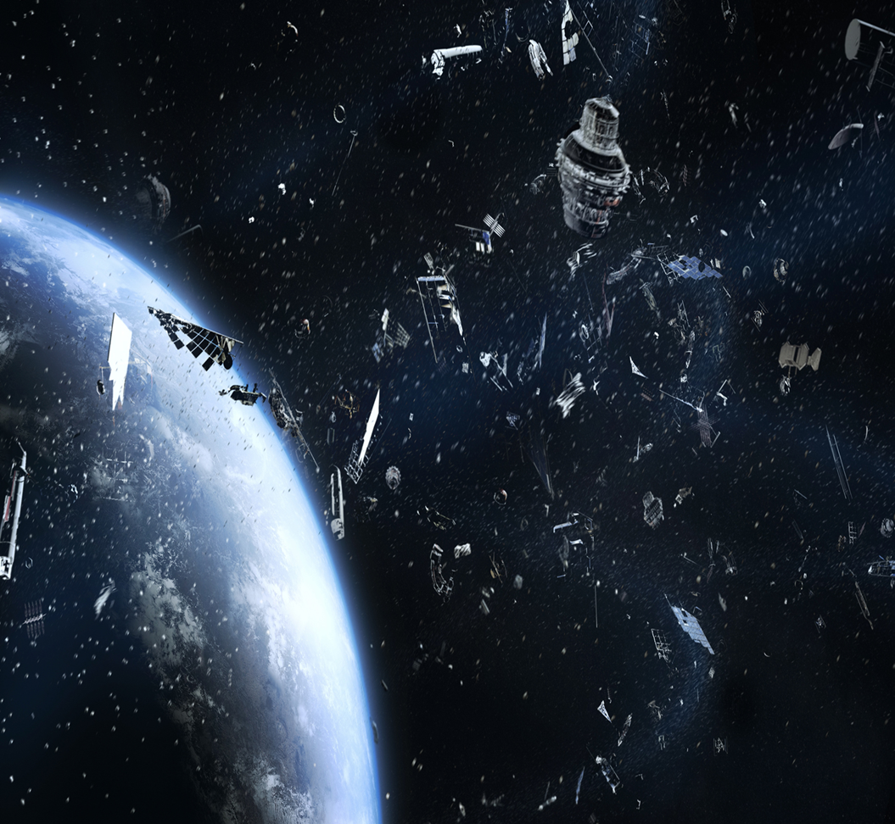
Proposal
Develop a model that can classify whether or not near-Earth objects pose a threat to satellites, disrupts natural phenomena, or is likely to impact Earth.
Utilize data from NASA’s Near-Earth Object Web Service for the model creation and testing.

Slide 5
Data
Used Nasa data from NEOwS API
Preprocessed data by removing unnecessary columns
Defined the target vector for items that are potentially hazardous
Data scaling required
Several models for preliminary evaluation
Is Potentially Hazardous
0 | 7666
1 | 552

Slide 6
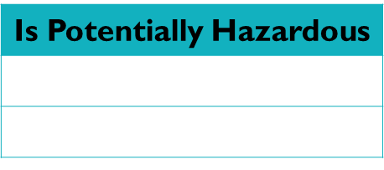
Models
Model Used for Predictions | Train Accuracy | Test Accuracy | Balanced Accuracy Score
SVC- rbf (Standard Scaler) | 0.940 | 0.931
SVC – rbf (Mini Max Scaler) | 0.935 | 0.927
Random Forest (max depth = 3) | 0.9436962518254097 |  | 0.5689501312335958
Suggestion: The model is not great at identifying hazardous asteroids potentially due to the extent to which the data is imbalanced. This false negative could be potentially catastrophic.
Efforts needed to improve model performance at detecting hazardous asteroids
Resampling needed: Resampled Value Counts

Slide 7
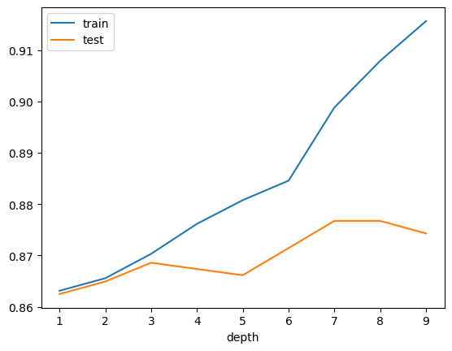
Resampled Data
Classification reports for Random Forest with max_depth of 3 using predictions from resampled model using random_oversampler vs original data.
Original_data
precision recall f1-score support
0 0.94 1.00 0.97 1905
1 0.84 0.14 0.24 150
accuracy 0.94 2055
macro avg 0.89 0.57 0.60 2055
weighted avg 0.93 0.94 0.91 2055
Using random_oversampler
precision recall f1-score support
0 1.00 0.83 0.91 1905
1 0.31 0.99 0.48 150
accuracy 0.84 2055
macro avg 0.66 0.91 0.69 2055
weighted avg 0.95 0.84 0.88 2055

Slide 8
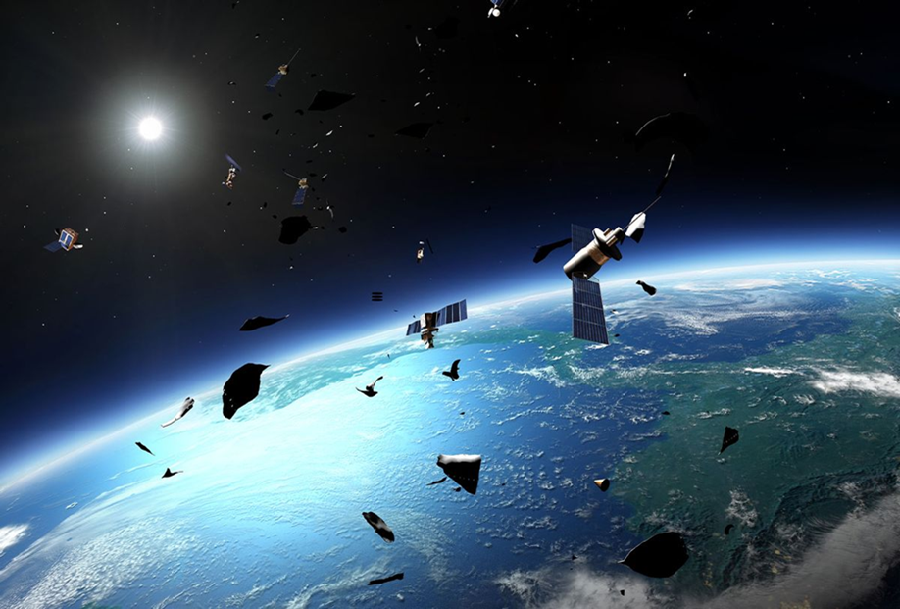
Improve Model Performance
Retrieve more real data from NASA
Modified create_dataset script to get additional records
Created new Random Forest Model
Target value counts with new data:
Is Potentially Hazardous
0 | 7666
1 | 2164
Random Forest Accuracy Scores with new data
Testing data accuracy score: | 0.8677786818551668
Training data accuracy score: | 0.8700488334237656
Balanced Accuracy Score: | 0.9088360226645182

Slide 9
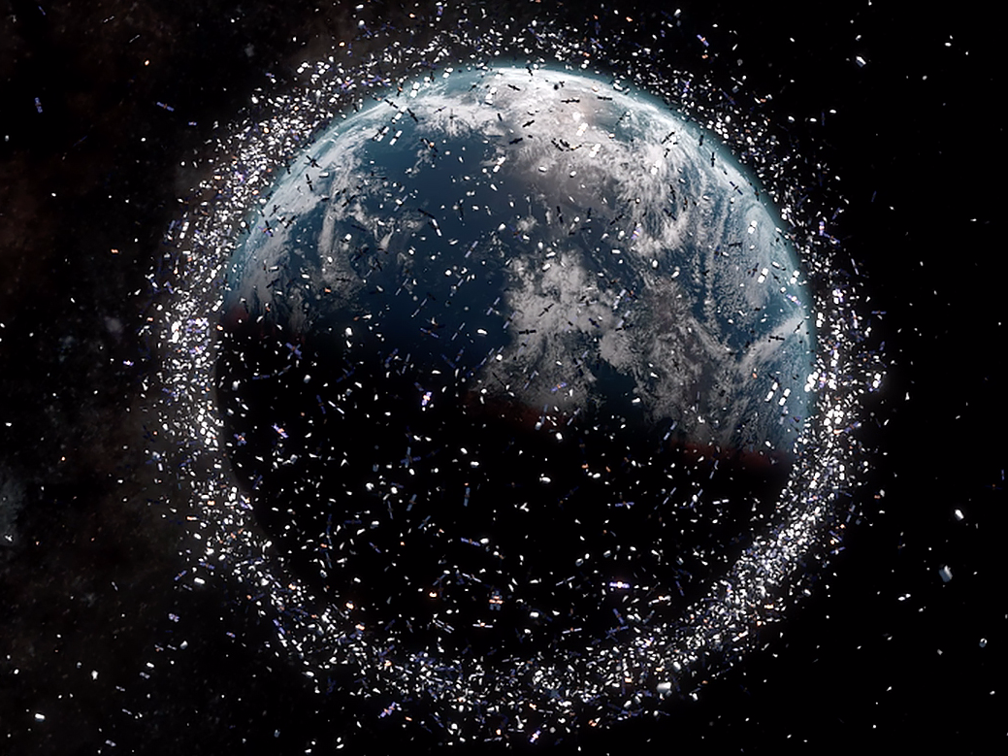
Classification Report with New Data
Classification report with New Data….
With new data
precision recall f1-score support
0 0.99 0.83 0.91 1902
1 0.63 0.98 0.77 556
accuracy 0.87 2458
macro avg 0.81 0.91 0.84 2458
weighted avg 0.91 0.87 0.88 2458

Slide 10
Conclusion
At the beginning of the project, we predicted that we’d be
able to ……
After looking at the data, it is

Slide 11
Questions

